Slide 1
if Statements

Slide 2
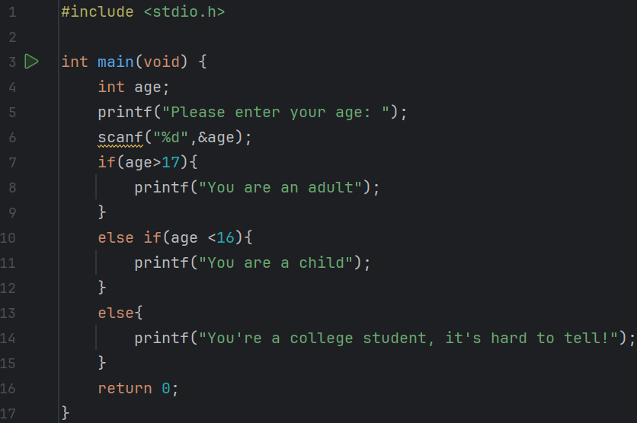
Predict
What do you think this code does?
Asks the user to enter their age. If they are older than 17 it says they are an adult. If they are under 16 it says they are a child. Otherwise, if they are 16, it says they are a college student.

Slide 3
Run
Download the code from Github and run it!
What does the code do?
Asks the user to enter their age. If they are older than 17 it says they are an adult. If they are under 16 it says they are a child. Otherwise, if they are 16, it says they are a college student.
Does this match your prediction?
Yes

Slide 4
Investigate
Investigation Activities
What is the name of the variable being used? age What data type does it hold?integer Annotate lines 4-14 to explain what each line of code does. How could you change line 7 but still get the same outputs? Could use a switch and case statement

Slide 5
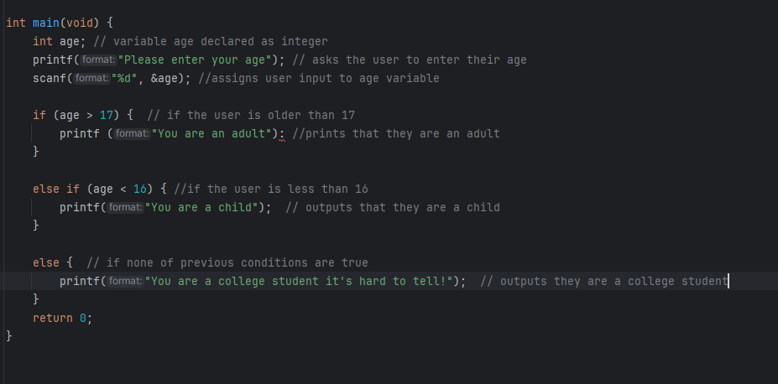

Slide 6
Modify
Modification Activities
Change the outputs to check age for a 12A film – it should: Allow over 12s to attend without an adult. Require under 12s to attend with an adult. Auto reject under 7s. Add a nested if that confirms that an adult is attending with the under 12.

Slide 7
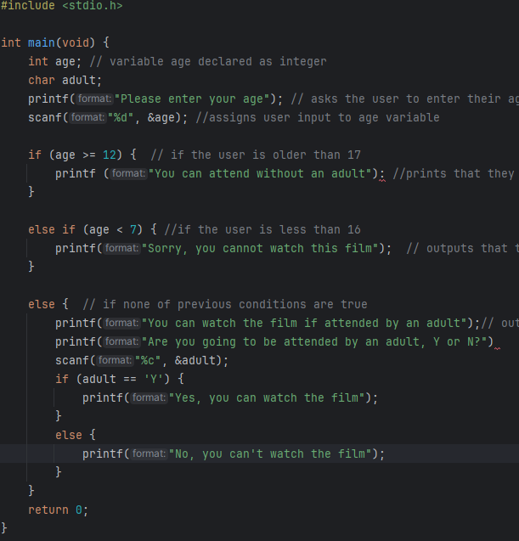

Slide 8
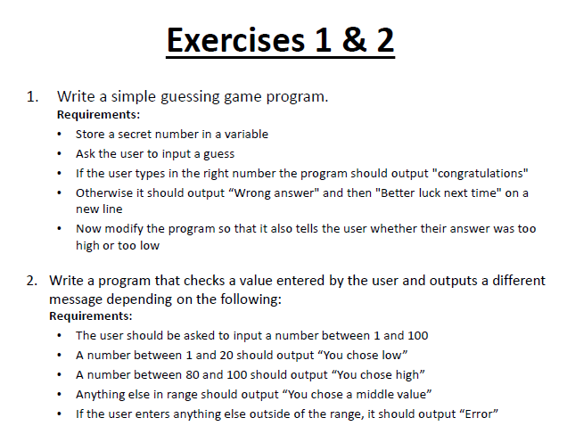
Make
Make Activities

Slide 9
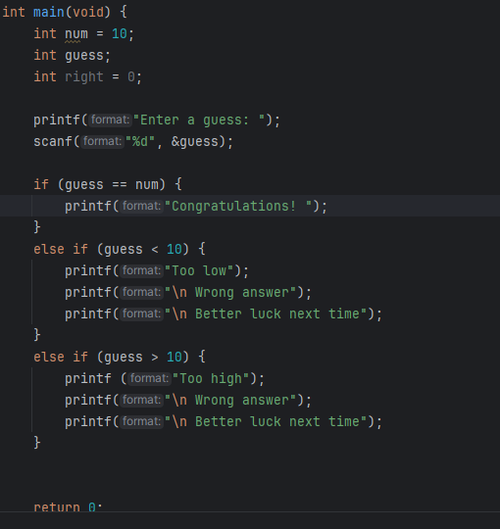
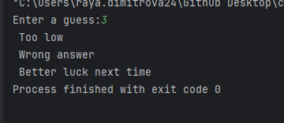

Slide 10
Make
Make Activities

Slide 11
